Slide 1
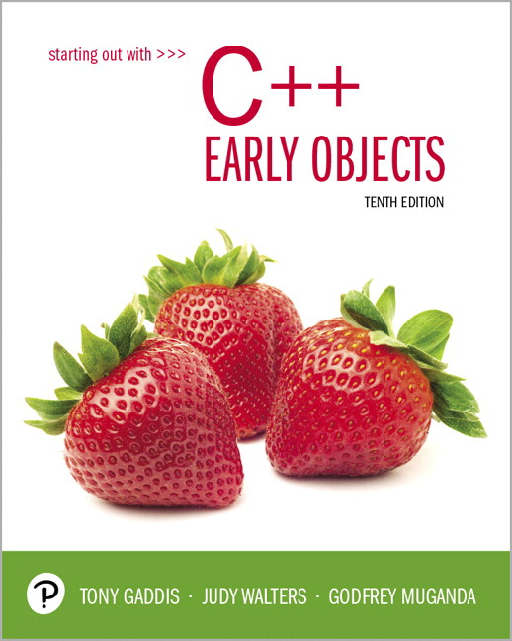
Starting Out with C++ Early Objects
Tenth Edition
Chapter 1
Introduction to Computers and Programming

Slide 2
Topics
1.1 Why Program?
1.2 Computer Systems: Hardware and Software
1.3 Programs and Programming Languages
1.4 What Is a Program Made of?
1.5 Input, Processing, and Output
1.6 The Programming Process

Slide 3
1.1 Why Program?
Computer – programmable machine designed to follow instructions
Program/Software – instructions that a computer follows to perform a task
Programmer – person with the right skills who designs, creates, and tests programs for computers
SO, without programmers, no programs; without programs, the computer cannot do anything

Slide 4
Programming – an Art and a Science
Artistry in programming:
Organization of the tasks that the program performs
How information is displayed
How the user interacts with the program
Science in programming:
Understanding of the language used to write the program
Understanding how to test the program, and to change it if it does not work as intended

Slide 5
1.2 Computer Systems: Hardware and Software
Hardware – Physical components of a computer
Main Hardware Component Categories
Central Processing Unit (CPU)
Main memory (RAM)
Secondary storage devices
Input Devices
Output Devices

Slide 6
Main Hardware Component Categories

Slide 7
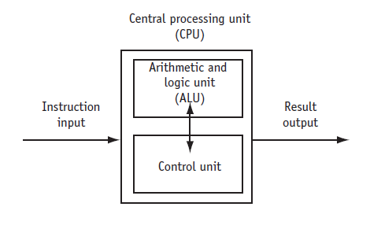
Central Processing Unit (CPU)
CPU – Hardware component that runs programs
Includes
Control Unit
Retrieves and decodes program instructions
Coordinates computer operations
Arithmetic & Logic Unit (ALU)
Performs mathematical operations

Slide 8
The CPU's Role in Running a Program
Cycle through:
Fetch: get the next program instruction from main memory
Decode: interpret the instruction and generate a signal
Execute: route the signal to the appropriate component to perform an operation

Slide 9
Main Memory
Holds both program instructions and data
Volatile – erased when the program terminates or computer is turned off
Also called Random Access Memory (RAM), because the CPU can access data and instructions from any memory location.

Slide 10
Main Memory Organization
Bit
Smallest piece of memory
Stands for binary digit
Hold an electrical charge
A positive charge is “on”
A negative charge is “off”
Byte
Is 8 consecutive bits
Has an address in memory
There are millions (or even billions) of bytes of memory in a computer

Slide 11
Secondary Storage
Holds data when the program is not running or when the computer is turned off
Several forms of secondary storage
disk drive: can be mounted inside the computer or connected to an external port. Data is stored magnetically or in solid-state memory.
flash: SD memory card, USB flash drive
optical: CD or DVD drive

Slide 12
Input Devices
Used to send information to the computer from outside
Many devices can provide input
keyboard, mouse, touch screen, microphone, scanner, digital camera, disk drive, CD/DVD drive, USB flash drive

Slide 13
Output Devices
Used to send information from the computer to the outside
Many devices can be used for output
Computer screen, printer, speakers, disk drive, CD/DVD recorder, USB flash drive

Slide 14
Software Programs That Run on a Computer
System software
programs that manage the computer hardware and the programs that run on the computer
Operating Systems
Controls the operation of the computer
Manages connected devices and access to storage devices
Allows programs to run
Utility Programs
Support programs that enhance computer operations
Examples: virus scanners, data backup, file compression
Software development tools
Used by programmers to create software
Examples: compilers, integrated development environments (IDEs)

Slide 15
1.3 Programs and Programming Languages
Program
a set of instructions directing a computer to perform a task
Programming Language
a special language used to write programs

Slide 16
Algorithm
Algorithm: a set of well-defined steps to perform a task or to solve a problem
Order is important. Steps must be performed sequentially

Slide 17
Programs and Programming Languages
Types of languages
Low-level: used for communication with computer hardware directly. Not very easy for a person to read.
High-level: closer to human language

Slide 18
From a High-level Program to an Executable File: 1of 3
Create a file containing the program with a text editor.
program statements: source code
file: source file
Run the preprocessor to convert source file directives to source code program statements.
Run the compiler to convert source program statements into machine instructions (machine code), which is stored in an object file.

Slide 19
From a High-level Program to an Executable File 2 of 3
Run the linker to connect hardware-specific library code to machine instructions, producing an executable file.
Steps b) through d) are often performed by a single command or button click.
Errors that occur at any step will prevent the execution of the following steps.

Slide 20
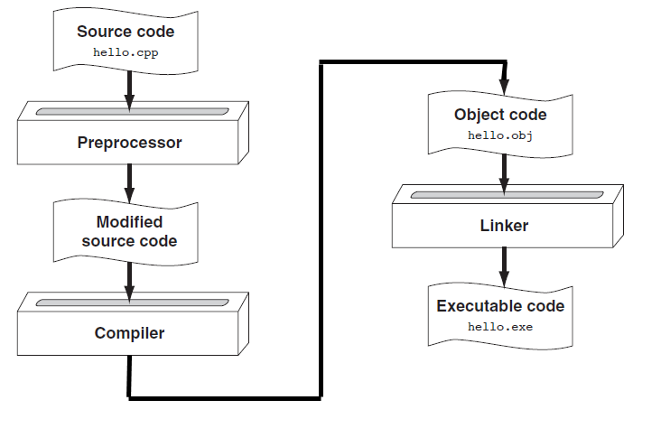
From a High-level Program to an Executable File 3 of 3

Slide 21
Putting It All Together
There are many software development systems that provide an integrated development environment (IDE). An IDE has the following:
text editor
compiler
debugger
other supporting utilities
a user interface that ties them all together
Notes:
See pr1-01.cpp

Slide 22
1.4 What Is a Program Made Of?
There are common elements in most programming languages
1) Language elements:
Key Words
Programmer-Defined Identifiers
Operators
Punctuation
Syntax
Notes:
See pr1-01.cpp

Slide 23
Example Program
#include <iostream>
using namespace std;
int main()
{
double num1 = 5,
num2, sum;
num2 = 12;
sum = num1 + num2;
cout << "The sum is " << sum;
return 0;
}

Slide 24
Key Words
Also known as reserved words
Have a special meaning in C++
Can not be used for another purpose
Written using lowercase letters
Examples in program (shown in green):
using namespace std;
int main()

Slide 25
Programmer-Defined Identifiers
Names made up by the programmer
Not part of the C++ language
Used to represent various things, such as variables (memory locations)
Example in program (shown in green):
double num1

Slide 26
Operators
Used to perform operations on data
Many types of operators
Arithmetic: +, -, *, /
Assignment: =
Examples in program (shown in green):
num2 = 12;
sum = num1 + num2;

Slide 27
Punctuation
Characters that mark the end of a statement, or that separate items in a list
Example in program (shown in green):
double num1 = 5,
num2, sum;
num2 = 12;

Slide 28
Lines vs. Statements 1 of 2
In a source file,
A line is all of the characters entered before a carriage return.
Blank lines improve the readability of a program.
Here are four sample lines. Line 3 is blank:
1. double num1 = 5, num2, sum;
2. num2 = 12;
3.
4. sum = num1 + num2;

Slide 29
Lines vs. Statements 2 of 2
In a source file,
A statement is an instruction to the computer to perform an action.
A statement may contain keywords, operators, programmer-defined identifiers, and punctuation.
A statement may fit on one line, or it may occupy multiple lines.
Here is a single statement that uses two lines:
double num1 = 5,
num2, sum;

Slide 30
Variables
A variable is a named location in computer memory.
It holds a piece of data. The data that it holds may change while the program is running.
The name of the variable should reflect its purpose
A variable must be defined before it can be used. Variable definitions indicate the variable name and the type of data that it can hold.
Example variable definition:
double num1;

Slide 31
1.5 Input, Processing, and Output
Three steps that many programs perform
Gather input data
from keyboard or mouse
from files on disk drives
Process the input data
Output the results of the processing
send it to the screen or a printer
write it to a file

Slide 32
1.6 The Programming Process 1 of 2
Define what the program is to do.
Visualize the program running on the computer.
Use design tools to create a model of the program.
Hierarchy charts, flowcharts, pseudocode, etc.
Check the model for logical errors.
Write the program source code.
Compile the source code.

Slide 33
The Programming Process 2 of 2
7. Correct any errors found during compilation.
8. Link the program to create an executable file.
9. Run the program using test data for input.
10. Correct any errors found while running the program.
Repeat steps 4 - 10 as many times as necessary.
11. Validate the results of the program.
Does the program do what was defined in step 1?

Slide 34
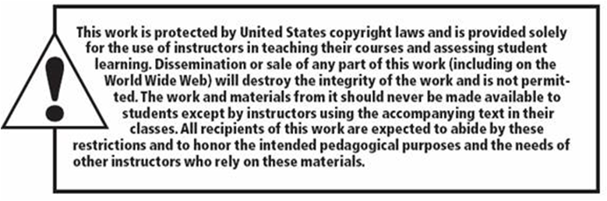
Copyright

